Slide 1
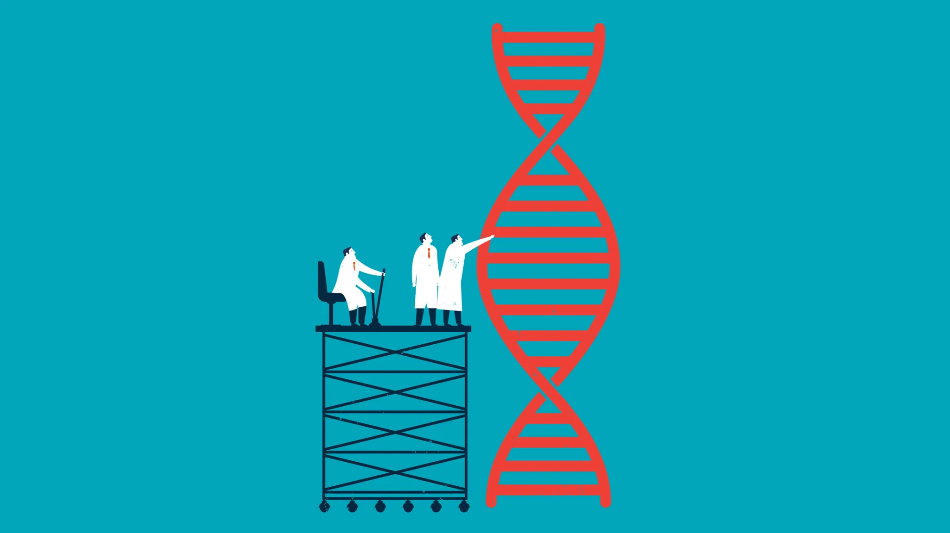
Classification of Highly Interacting Regions of the Genome with Explainable AI
Shreya Pawaskar - 4947
Radhika Sethi - 4456
Aanchal Tulsiani - 4964
External Guide: Dr. Leelavati Narlikar
Internal Guide: Mrs. Pranjali Deshpande
Mentor: Miss. Anushua Biswas
Notes:
Only title - prob statement on the next slide , agenda on the next
Ext guide, internal

Slide 2
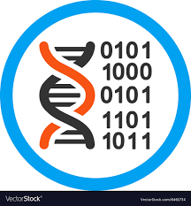
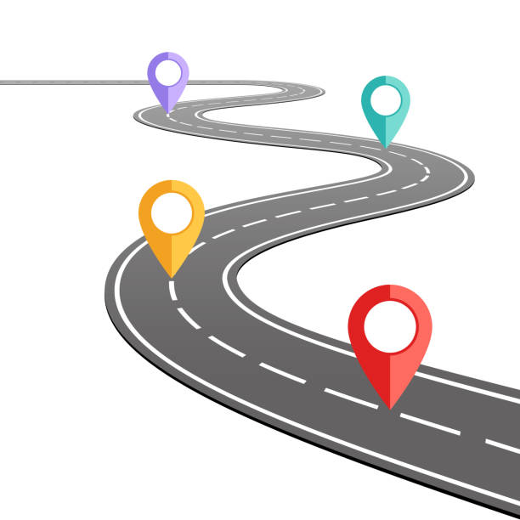
Road Map
Problem Statement
Markov models with Cross Validation with shift of 200
Markov models with cross validation with shift of 500
Markov models with cross validation on Complemented Data
Deep Learning Review
Current Paper Implementation
Conclusion
References
Notes:
Intro-probolem stm - motivation -

Slide 3
Problem Statement
Our Problem Statement is as follows:
“To identify the regions governing gene regulation and classify them as highly interacting and non-interacting regions”
The Objectives being covered are :
Learn how to model biological sequencing and DNA data. Understand their underlying properties and how to find patterns in them
Efficiently use deep learning algorithms to distinguish TADs and their boundaries.
Classify genomic sequences as potentially interacting regions or non-interacting regions
Find which traits of TADs in these regions make them more interactive.
Understand how these specific regions influence gene regulation.
Find genomic sequence properties which influence the transformation of a cell into a diseased cell.

Slide 4
Markov models with Cross Validation

Slide 5
Markov models with cross validation
Tad vs Left classification - with random_state
Shift: 200

Slide 6
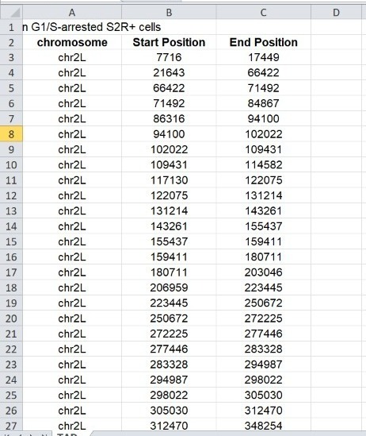
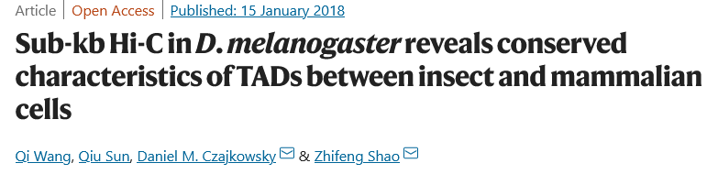
Data
Accession number: GSE101317
Link: https://www.nature.com/articles/s41467-017-02526-9
NCBI -> downloaded the files with domain coordinates

Slide 7
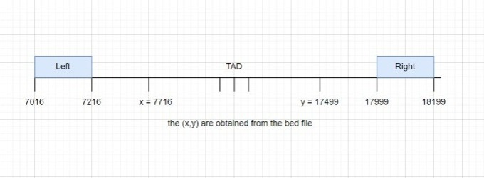
Shift of 200
To get the coordinates of the left and right boundaries, we take a shift of 200 coordinates and generate 3 files accordingly.
Sequence length of 200 char
After generating the right bed files, we used 2BitToFa to generate it’s fasta file, and then converted the fasta file into a suitable database for our processing

Slide 8
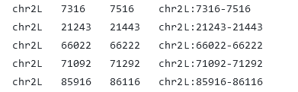

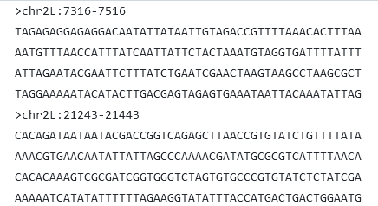
Shift of 200
1. Bed file
3. Text file for models
2. Fasta file

Slide 9
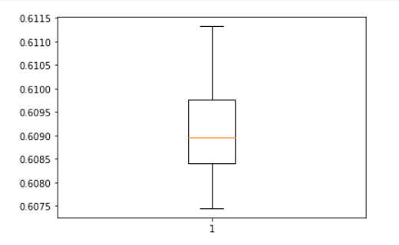
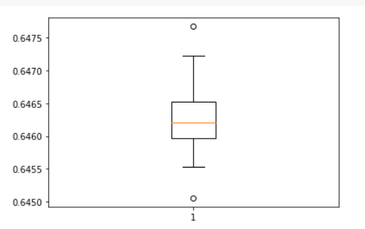
Markov models with cross validation
Tad vs Left classification - with random_state
Acc box plot - 20 x (avg of 8 folds) Auc box plot - 20 x (avg of 8 folds)

Slide 10
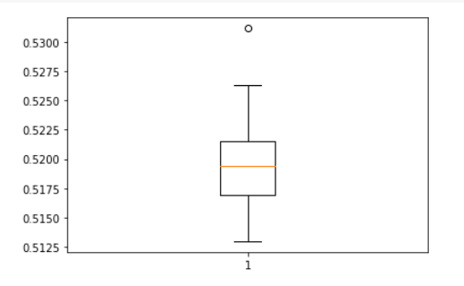
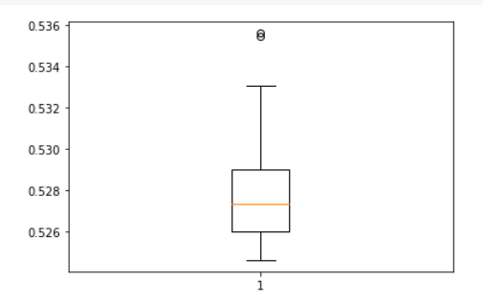
Markov models with cross validation
Left vs Left classification - with random_state
Acc box plot - 20 x (avg of 8 folds) Auc box plot - 20 x (avg of 8 folds)

Slide 11
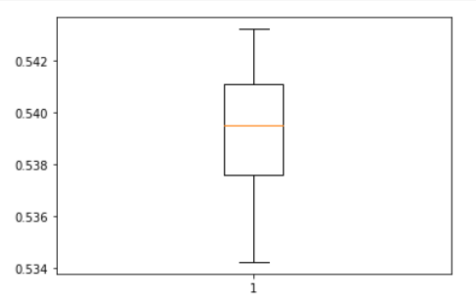
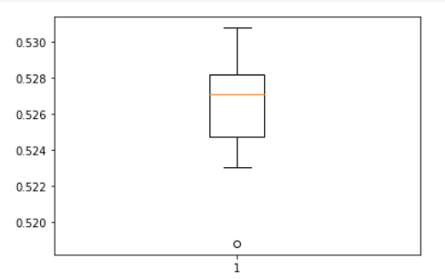
Markov models with cross validation
Left vs Right classification - with random_state
Acc box plot - 20 x (avg of 8 folds) Auc box plot - 20 x (avg of 8 folds)

Slide 12
Markov models with cross validation
Tad vs Left classification - with random_state
Shift: 500

Slide 13
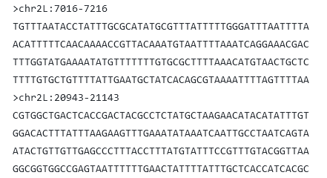
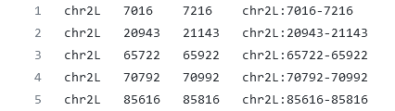

Shift of 500
2. Fasta file
To get the coordinates of the left and right boundaries, we take a shift of 500 coordinates and generate 3 files accordingly.
Sequence length of 200 char
After generating the right bed files, we used 2BitToFa to generate it’s fasta file, and then converted the fasta file into a suitable database for our processing
1. Bed file
3. Textfile for models

Slide 14
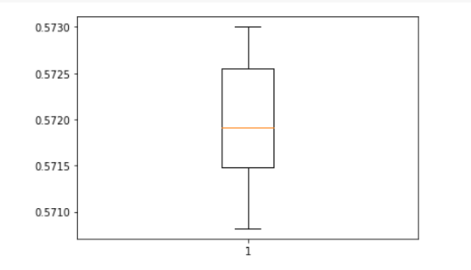
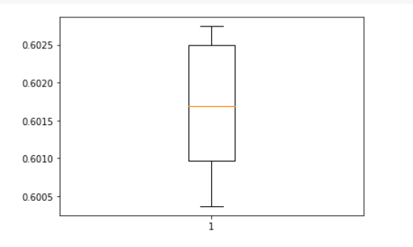
Markov models with cross validation
Tad vs Left classification - with random_state
Acc box plot - 20 x (avg of 8 folds) Auc box plot - 20 x (avg of 8 folds)

Slide 15
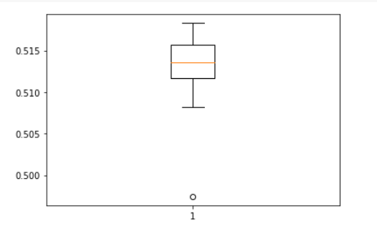
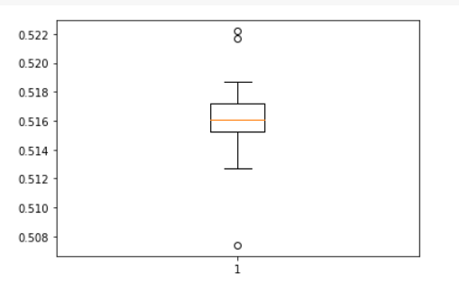
Markov models with cross validation
Left vs Left classification - with random_state
Acc box plot - 20 x (avg of 8 folds) Auc box plot - 20 x (avg of 8 folds)

Slide 16
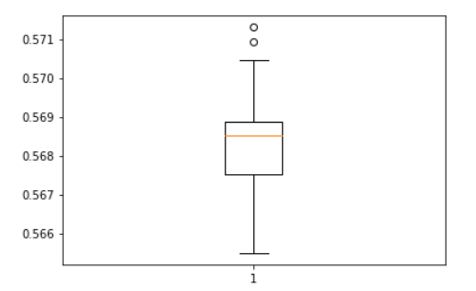
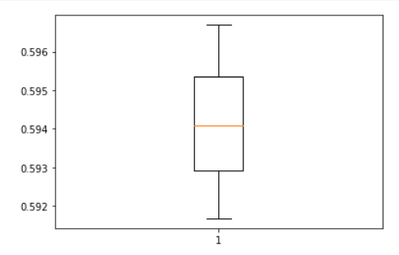
Markov models with cross validation
Left vs Right classification - with random_state
Acc box plot - 20 x (avg of 8 folds) Auc box plot - 20 x (avg of 8 folds)

Slide 17
Complement
SUMMARY

Slide 18
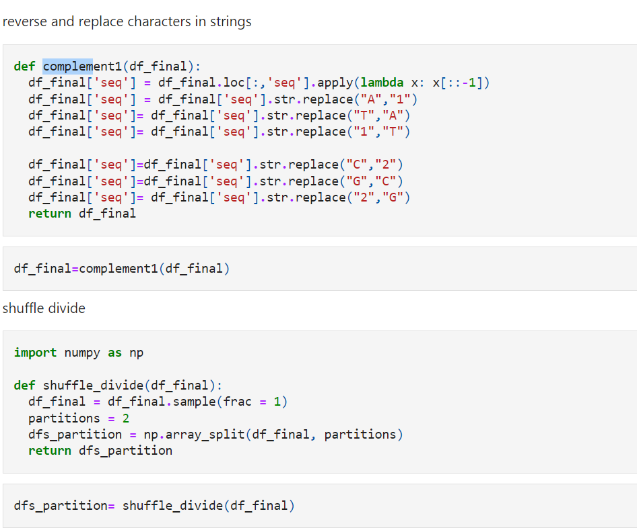
DNA Complement
We realised that on classification of left vs right boundary, there were some signals, as the ideal accuracy should have been 0.50
For each input sequence, we took the complement of it and added it to our training dataset

Slide 19
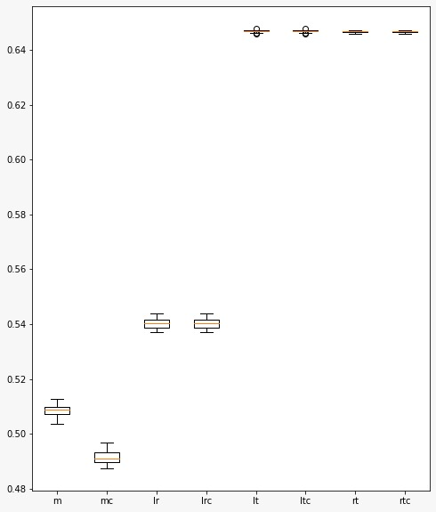
Box plot of ROC:
m - mixing the left and right datasets, dividing them into 2, and training separately.
mc - the same, but while also taking the complement of the sequences while training
lr - classification between left and right boundary
lrc - classification between left and right boundary (including their complements while training)
lt - classification between left and tad region
ltc - classification between left and tad region (including their complements while training)

Slide 20
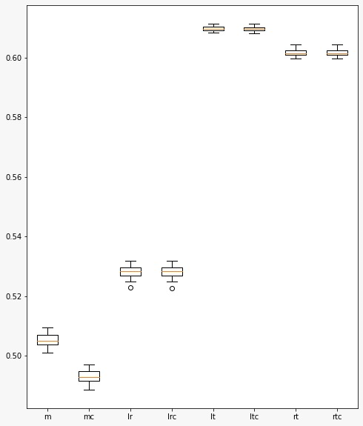
Box plot of ACC:
m - mixing the left and right datasets, dividing them into 2, and training separately.
mc - the same, but while also taking the complement of the sequences while training
lr - classification between left and right boundary
lrc - classification between left and right boundary (including their complements while training)
lt - classification between left and tad region
ltc - classification between left and tad region (including their complements while training)

Slide 21
DEEP LEARNING IMPLEMENTATION
SUMMARY

Slide 22
LITERATURE REVIEW
Paper | Method | Input | Output
SBTD (Spectral Based TAD Detector) - 2021 | We deal with the TAD recognition problem from the view of the graph segmentation. The bins on chromatin are abstracted into vertices in the graph. According to the self-association of TADs, we believe that bins within a TAD have similar interaction patterns. Therefore, we innovatively introduce cosine similarity to quantify the interaction patterns between upstream and downstream bins. The similarity will be used as the weight of the edges between the bins. Use spectrogram cutting theory to cut the graph into small subgraphs, and extract TADs from them. | Here we treat the chromatin interaction matrix as a graph Introduce cosine similarity as a measure of the interaction patterns between bins. | The TADs identified by SBTD show a highly similar histone modification signal enrichment pattern at the boundary. The motif enrichment analysis shows that compared with the background region, the DNA motifs of known insulator proteins are significantly enriched in the TAD boundary region identified by this method, which proves the high performance of it.
https://github.com/chunlin-long/SBTD https://link.springer.com/article/10.1007/s12539-021-00453-4

Slide 23
Paper | Method | Input | Output
DEEP CLIP | Deep neural network that uses shallow 1D convolutional layers to find and enhance features of a set of presented sequences. This is followed by a Bidirectional Long Short Term Memory (BLSTM) layer. This layer utilizes the extracted features and contextual data of the sequences to find areas of the RNA sequences related to RBP binding. The output layer is made up of a single fixed node that utilizes the sigmoid activation function No bias parameter. For gradient descent optimization, ADAM is employed. | Takes single or more RNA oligonucleotides (short RNA sequences) Consist of positive (bound) sequences, which are assigned to class 1, and negative (unbound) sequences assigned to class 0. 80% of the input data is used for training 10% is used for validation Last 10% for testing | Predicts binding probability Calculates a binding profile

Slide 24
Paper | Method | Input | Output
DEEP MOTIF | Multiple convolutional layers and a highway multi-layer perceptron (MLP) to make the binary classification. the final model has 3 convolutional layers with 128 filters of length-5 at each layer 5 fully connected highway MLP layers with 32 nodes at each layer Raw nucleotide characters = inputs, which are encoded into a one-hot encoding. Dropout for regularization in the convolutional layers. Fully connected highway network after the max-pooled output of the convolutional layers. Output of the highway MLP is fed to a 2-way softmax function. | Train a different model for each TF dataset Vary the hyperparameters for each model. 108 leukemia cell TF datasets Each TF dataset has an average of 30,819 training sequences, Each sequence consists of 101 DNA-base characters (A, C, G, T). | Predictions on biomedical sequences Produces a motif that represents a positive binding site class. Median AUC is 0.951

Slide 25
Paper | Method | Input | Output
PreciseTAD | Learns the associations between genomic annotations and boundaries detected from low-resolution Hi-C matrices Transfers the learned associations at base-level resolution Predicts the probability of each base being a boundary Utilizes the random forest (RF) algorithm trained on chromatin state (BroadHMM), histone modification (HM), and transcription factor binding site (TFBS) annotation data. Methods: Density-based clustering (DBSCAN) and partitioning around medoids (PAM) to detect annotation-guided boundary regions Summits points with the highest boundary probability. | TAD and loop boundaries called by Arrowhead56 and Peakachu17 tools = training and testing data. Input: Takes BED-formatted genomic coordinates of domain boundaries detected from low-resolution Hi-C data, and coordinates of high-resolution genomic annotations from ENCODE or other consortia. | Provides functions to predict the location of boundaries of TADs and chromatin loops at base-level resolution.
Ref: https://github.com/dozmorovlab/preciseTAD/

Slide 26
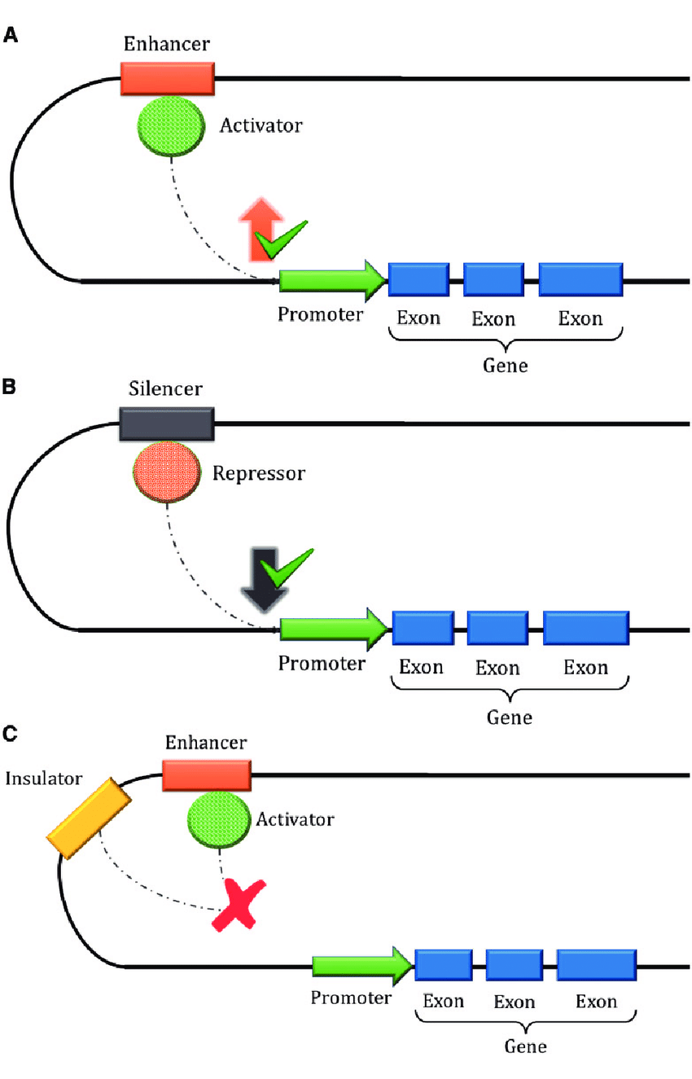
Current paper implementation
Paper: Enhancer–silencer transitions in the human genome
Enhancers are short motifs that contain binding sites for transcription factors
A sequence that causes a decrease in gene activity is called a silencer
Multiclass convolutional neural network (CNN) model with three nodes in the output layer representing silencers, enhancers, and regulatory neutral DNA sequences
Link: https://genome.cshlp.org/content/early/2022/02/01/gr.275992.121.full.pdf

Slide 27
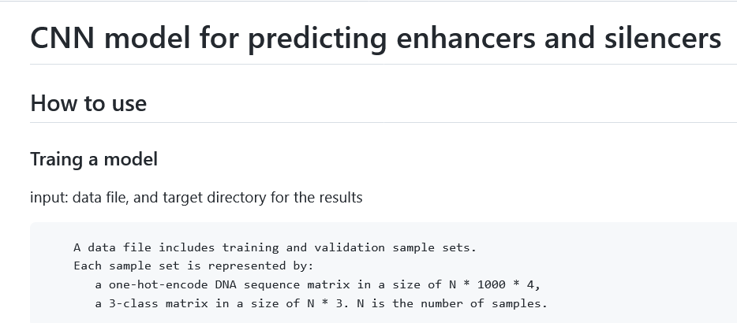
Current paper implementation

Slide 28
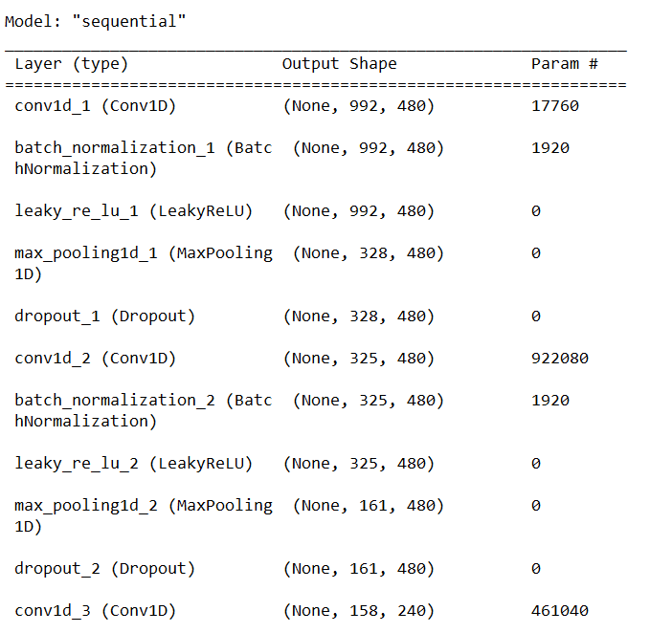
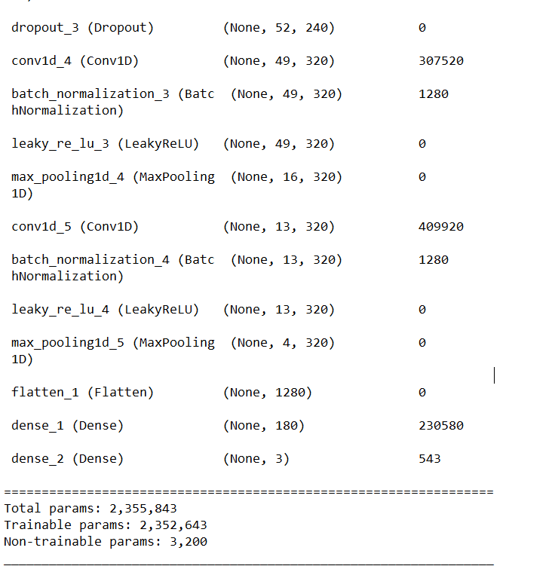
CNN Model Summary

Slide 29
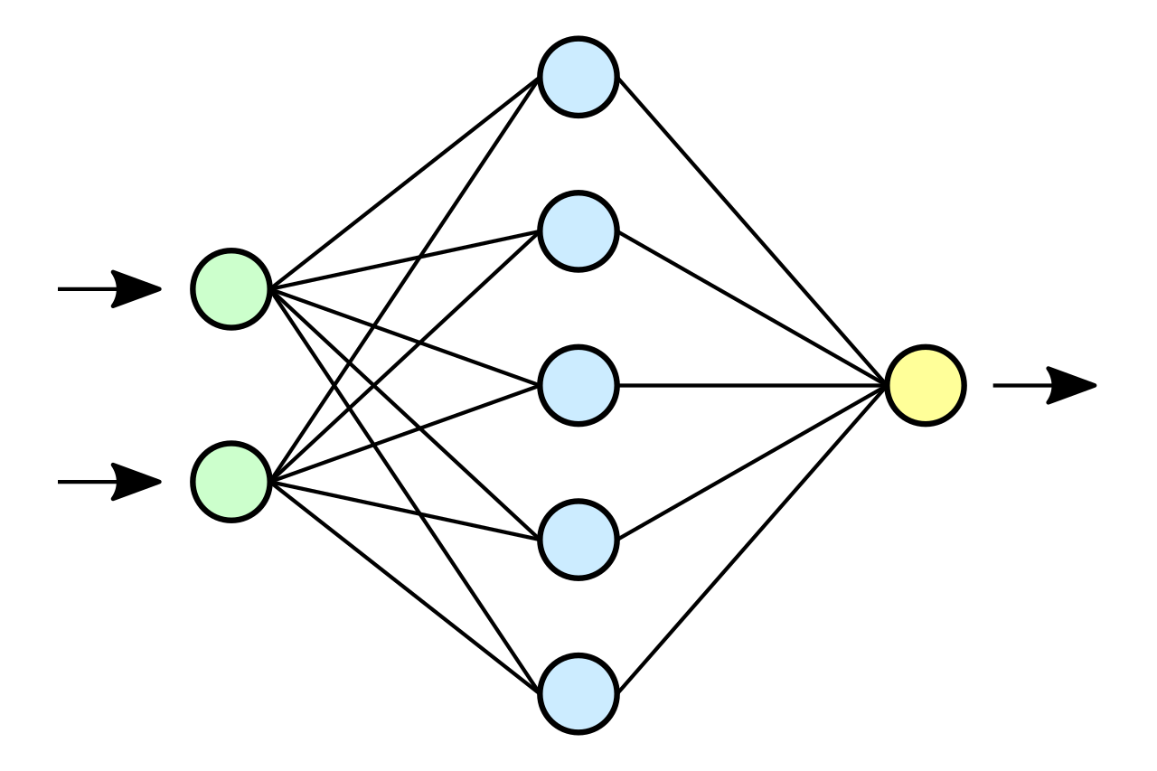


Conclusion
Building a CNN architecture
The output will have 2 classes - 0 and 1 to classify between a TAD and boundary region
Libraries:
Keras - Open-source software library that provides a Python interface for artificial neural networks.
Pytorch - Open source machine learning framework based on the Torch library, used for applications such as computer vision and natural language processing

Slide 30
References
https://genome.cshlp.org/content/early/2022/02/01/gr.275992.121.full.pdf
https://genome.cshlp.org/content/32/3/437.full
https://link.springer.com/article/10.1007/s12539-021-00453-4
https://en.wikipedia.org/wiki/Topologically_associating_domain
https://www.ncbi.nlm.nih.gov/pmc/articles/PMC8142020/
https://pubmed.ncbi.nlm.nih.gov/29654311/
https://www.biorxiv.org/content/10.1101/2020.09.03.282186v3
https://www.ncbi.nlm.nih.gov/pmc/articles/PMC4838359/
https://www.nature.com/articles/nature11082
https://arxiv.org/abs/1605.01133v2
https://github.com/QData/DeepMotif
https://paperswithcode.com/paper/deep-motif-visualizing-genomic-sequence
https://academic.oup.com/nar/article-lookup/doi/10.1093/nar/gkaa530#supplementary-data
https://www.nature.com/articles/s41467-017-02526-9

Slide 31
Thank you !

